Slide 1
Notes:
Introduction: this presentation will give some details of Charles Darwin’s life and the background to his groundbreaking ideas on evolution by means of natural selection.

Slide 2
Notes:
Slide 2: Darwin was born in 1809 and even as a small child was fascinated by all aspects of nature. He was always collecting rocks, plants and insects in the fields and hedges around his home.

Slide 3
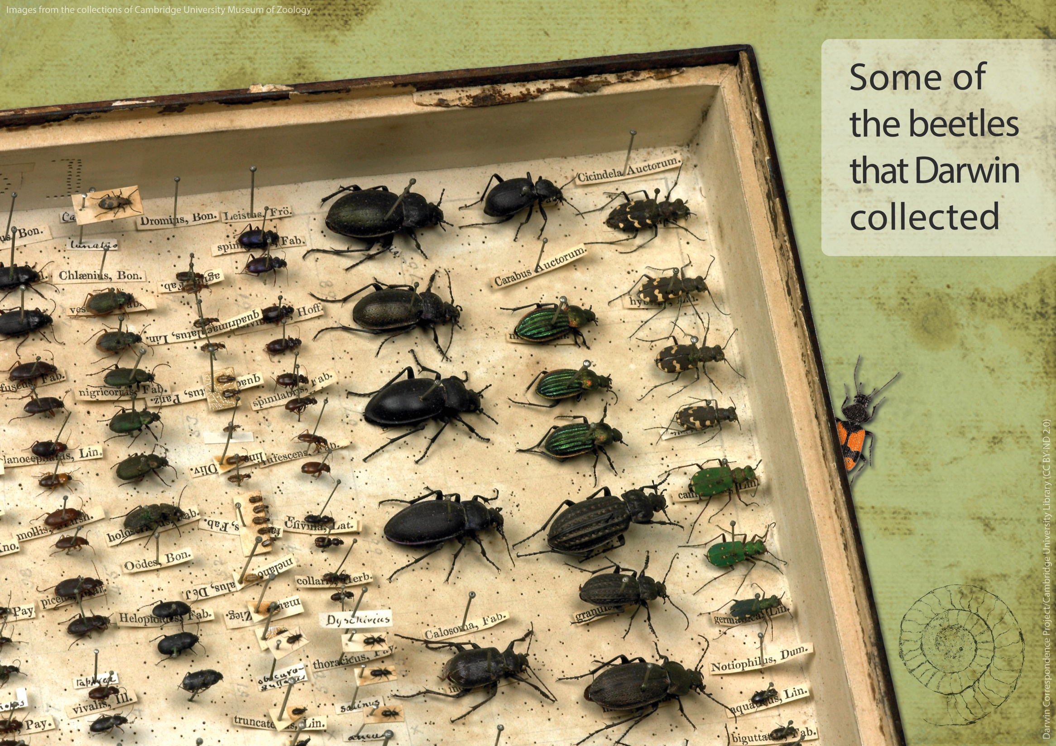
Notes:
Slide 3: When he was young, Darwin’s hobby meant that he always wanted to have better collections than his friends and siblings. As he got older he became more fascinated by the amount of variety in plants and animals. Having collections helped him to notice the sometimes tiny differences between members of the same family. He began to wonder what had caused them.

Slide 4
Notes:
Slide 4: Darwin studied medicine at Edinburgh University for a time but then went to Cambridge University with the aim of becoming a clergyman. However he wasn’t a great student and was much more interested in exploring the local countryside and collecting what he found. His friend, Albert Way, made this sketch of him riding a beetle and holding his collecting net.

Slide 5
Notes:
Slide 5: When he was 21 one of his professors at Cambridge University, John Stephens Henslow, offered him the opportunity to join a ship called HMS Beagle as a companion to Caption FitzRoy who would be free to make all kinds of natural history collections. Henslow said he had recommended Darwin as the best person he knew of for ‘collecting, observing, & noting any thing worthy to be noted in Natural History’.

Slide 6
Notes:
Slide 6: The voyage was initially to last for two years but eventually lasted for almost five. Darwin was a terrible traveller and was seasick for most of the voyage. Sometimes he wrote letters home saying how he hated being at sea. He later said it was the most exciting time in his life.

Slide 7
Notes:
Slide 7: During this time Darwin spent over three years on land, making collections of fossils, animals, birds, fish, insects, rocks and plants. He sent hundreds of specimens back home on other ships; many were things that people in England had never seen before.

Slide 8
Notes:
Slide 8: He found these bones of an elephant-sized animal called a Megatherium, or giant ground sloth, in South America. It became extinct about 8,000 years ago. This is how the Megatherium would have looked. Darwin found many fossils during the voyage and they were all carefully packed and labelled to be sent back to England. The fossils and bones helped him to consider how things adapted to suit their environment.

Slide 9
Notes:
Slide 9: He observed how plants and animals had characteristics that helped them to survive in all the different places that he had visited. These birds that Darwin saw on the Galápagos Islands are all from the same family, but they have developed different-shaped beaks to help them access the food available on the specific island where they live. Darwin didn’t realise or understand the significance of this until many years later.

Slide 10
Notes:
Slide 10: When he finally returned from the voyage in 1836, he was quite famous as a result of all the specimens he had sent home. He married Emma Wedgwood and settled in Down House in Kent. He started to sort through the collections that he had made and sent them to different experts to help classify and understand his finds.

Slide 11
Notes:
Slide 11: Darwin did not travel far again but wrote to 2000 people all over the world to help him develop his ideas. For the next 20 years he researched the collections. Going on the Beagle voyage helped Darwin to see the richness and variety of the natural world close up. After he returned, the world came to him in the form of letters and sometimes specimens too.

Slide 12
Notes:
Slide 12: Darwin was fascinated by all kinds of animals. He became interested in pigeons and how they could be bred to change their characteristics over generations. He saw, for example, how a pigeon with a small beak could be selected to breed with a another small-beaked bird to ensure that their offspring would have a small beak too. This selection of characteristics to be passed on to the next generation made him think about what happened in the natural world and how characteristics were passed on naturally and why.

Slide 13
Notes:
Slide 13: Darwin grew up with dogs and kept them throughout his adult life. He was fascinated by the traits and characteristics of particular breeds and how these could be passed on. Darwin studied the breeding of domestic animals, such as dogs and pigeons, to help him understand how species gradually evolved in the natural world and what caused those changes to happen.

