Slide 1
Darwin and religion
Topic: Religious Education
Ages: 11-14
Key stage: 3
Notes:
This presentation will introduce key moments in Darwin’s life and provide a context for the accompanying activities.

Slide 2
Who was Charles Darwin?
Notes:
What do we know about Darwin? What is he famous for?
Darwin was born in Shrewsbury in 1809. He had a lifelong fascination for nature, observation and discovery.
He went on to become the most influential scientist, writer and thinker on evolution.

Slide 3
Darwin as a young man
Notes:
In 1825, when Darwin was 16, he went to Edinburgh University to study medicine but did not enjoy his studies and left after two years. He then enrolled for a classical degree at Cambridge University and was a student at Christ’s College. He had an idea to become a clergyman with a country parish. This appealed to Darwin as it would allow him to continue exploring the natural world; a common pursuit for a clergyman at that time.
As he wrote to his friend and cousin, William Darwin Fox:
‘To a person fit to take the office, the life of a clergyman is a type of all that is respectable and happy: & if he is a Naturalist and has the ‘Diamond Beetle’, ave Maria; I do not know what to say!’

Slide 4
Darwin receives an offer
Notes:
In August 1831 when Darwin was 22, his botany professor, John Stevens Henslow, wrote to him unexpectedly. Henslow offered Darwin the opportunity to join young Captain FitzRoy aboard HMS Beagle on a voyage around the world to create sea-charts. The ship was to sail round the coast of South America and home via Australia and Mauritius. The offer had been made to two others before Darwin, but they had had to turn it down for family reasons. After satisfying his father’s initial reservations, Darwin was able to accept the opportunity to join the voyage.

Slide 5
Where did the HMS Beagle go?
Notes:
HMS Beagle set sail from Plymouth in December 1831. During the five year voyage much time was spent exploring the coastline of South America. Darwin was often free to carry out his own expeditions and spent a total of three years on land, exploring, observing and collecting. Darwin wrote regularly to his friends and family about his research, the new lands and people he encountered, and the wonder of the natural world. The ship returned home via the Galápagos Islands, New Zealand, Australia and South Africa. Darwin arrived back in Plymouth in October 1836, almost five years after setting off.

Slide 6
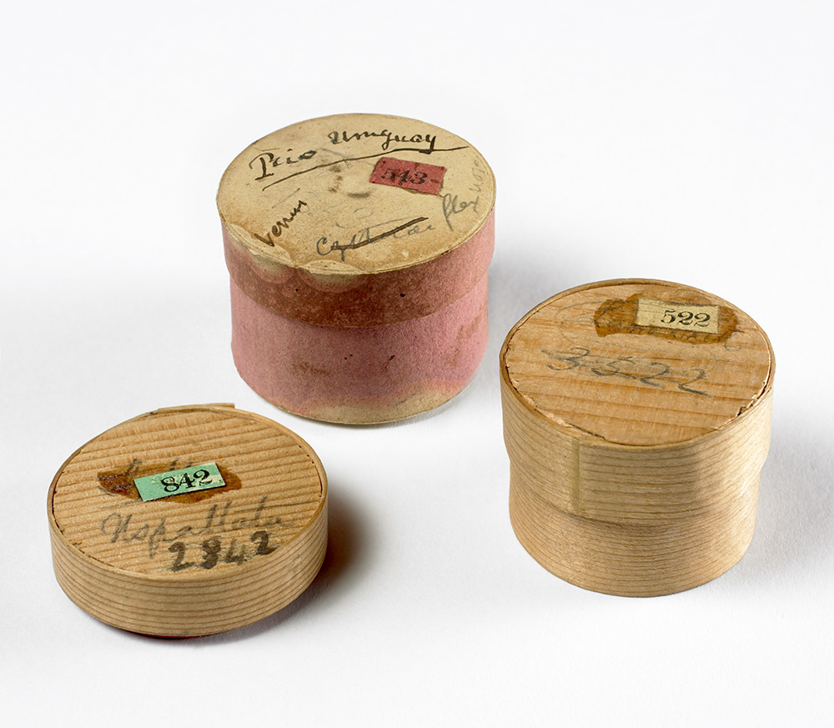
Specimens big and small
Notes:
Darwin collected and sent back many thousands of samples and specimens including rocks, fossils, insects, animals, and plants. The bones he found belong to a Megatherium (giant ground sloth) that lived in South America around 5.3 million years ago. Darwin’s collections were sometimes packaged in whatever containers he had to hand, including these pill boxes which were used to protect some geology samples. The trunks full of specimens were sent home via ships that were returning to England.

Slide 7
Change over time
Notes:
The remarkable specimens that he collected during the voyage gave Darwin food for thought. Whilst at Cambridge had been particularly interested in geology, the study of how rocks form and change over time. He had also studied variety and adaptation in plants with Professor Henslow and was fascinated by the question of where life came from and what caused life-forms to change. The observations and discoveries he made on the Beagle voyage inspired Darwin’s research for many years to come.

Slide 8
Life after the voyage
Notes:
In 1836 Darwin returned to England with a career’s worth of scientific observations. With his vast collection of new specimens and
observations, Darwin became an important member of the British scientific community. Darwin wrote four books based on the voyage,
including his popular Journal of researches (later known as Voyage of the Beagle). He spent twenty further years developing and testing his
ideas before publishing on evolution and natural selection.
He married Emma Wedgwood and they soon moved to Down House in Kent. They raised a family (ten children, of whom seven survived to
adulthood). Darwin worked and carried out most of his research at home, often enlisting the help of his family. He published his most famous
book: On the Origin of Species, in 1859, which stands as the foundation of evolutionary biology.

Slide 9
Reactions to ‘Origin’
‘I never saw a word in his writings which was an attack on Religion. He follows his course as a Naturalist and leaves Moses to take care of himself.’
Revd John Brodie Innes,
1 December 1878
Notes:
It is often thought when Darwin published ‘On the Origin of Species’ there was a strong division between those who supported science and
those who believed in God. The book prompted mixed reactions. Some members of the religious community showed support for his research
and felt and that it did not compromise their faith.

Slide 10
Reactions to ‘Origin’
‘Parts of it I admired greatly; parts I laughed at till my sides were sore; other parts I read with absolute sorrow;’
Adam Sedgwick,
24 November, 1859
Notes:
Others, such as his respected Cambridge geology professor, Adam Sedgwick, were less convinced. Sedgwick feared for the future of morality if Darwin’s ideas were to be believed.

Slide 11
Darwin’s views on religion
‘… it has always appeared to me more satisfactory to look at the immense amount of pain & suffering in this world, as the inevitable result of the natural sequence of events, … rather than from the direct intervention of God.’
Darwin to Mary Boole,
14 December 1866
Notes:
In his letters Darwin’s views on religion are expressed as mixed, changing and with an anxiety not to cause distress to others on the matter.
He shows respect for the church and often a desire to keep his own views on religion to himself.

Slide 12
Darwin and Down
Notes:
At home in the village of Down, Kent, Darwin contributed to the welfare of the local community. He supervised the church and school finances, supported local charities and carried out pastoral duties in the absence of the parson. He did not become a clergyman, as he once thought he might, but was involved with the church on a regular basis. Whatever his changing views on religion, he was happy to support the church as an important institution in the community.

Slide 13
Acknowledgements
Images
Slide 2: Artwork based on sketch of Darwin by George Richmond held at Cambridge University Library, DAR 225:119, DAR 14.6
Slide 3: Cambridge University Library
Slide 4: US National Library of Medicine IMH (B014334), CUL (DAR 97: B4)
Slide 5: CUL, map data by Free Vector Maps
Slide 6: Images from collections at Cambridge University Museum of Zoology/
Sedgwick Museum, artist impression of Megatherium, CUL
Slide 7: CUL DAR 44.13, giant tortoise: Vanessa Green, Galapagos Conservation Trust
Slide 8: CUL, artwork based on DAR 233.1:17, Keynes.M.2.27, DAR 233.2.18
Slide 9: Downe Church, Kent
Slide 10: Adam Sedgwick NPG D5929 © National Portrait Gallery, London
(CC BY-NC-ND 3.0)
Slide 11: CUL (DAR 225:119)
Slide 12: Down House and Darwin family, CUL (DAR -225:29.a, DAR 219.12:9)

